Slide 1
ElectViz Election Data Visualization For Media
This project focuses on analyzing Indian election data and presenting insights through an interactive Power BI dashboard. Our goal was to transform raw public election data into meaningful visual insights that can support media reporting, political analysis, and decision-making.
Team Members
Arjun Srivastava
Mayur Shivaji Raut
Kotha Akshaya
Srilakshmi Sowjanya
Tools Used
Power BI • Power Query • Excel/CSV • DAX Measures • Data Modeling Techniques
Notes:
Introduce team & project brief

Slide 2
Team Introduction
We are a team passionate about data analytics, visualization, and decision intelligence. Through this project, we aimed to understand real-world electoral datasets, clean and model the data, and design dashboards that simplify complex election information.
This project enhanced our skills in teamwork, analytical thinking, BI tool usage, and delivering insights for real-time decision-making.
Project Duration: 8 Weeks
Notes:
Explain team learning goal & duration

Slide 3
Project Objective
The objective of this project is to build a dynamic dashboard that enables viewers to interpret election data clearly. It allows media professionals and analysts to:
Explore party performance across states
Analyze demographic trends among candidates
Understand voter turnout and postal vote behavior
Compare candidate assets vs. criminal cases
Review winning insights at national and constituency level
We converted public election datasets into interactive visuals that highlight electoral patterns and political insights.
Notes:
State problem & key outcomes

Slide 4
Data Source
Primary Source:
Election Commission of India official election data.
Dataset Contents:
Candidate information (name, party, gender, education)
Constituency & state mapping
Votes secured & postal vote count
Candidate assets, liabilities & criminal cases
Election result (win/loss, margin)
This data was downloaded in CSV/Excel format and prepared for analytical use.
Notes:
Highlight authenticity of data

Slide 5
Team Contribution
Members | Contribution
Arjun Srivastava | Data cleaning, DAX, dashboard insights, final integration
Mayur Shivaji Raut | Data collection, preprocessing, attribute mapping
Kotha Akshaya | DAX measures, KPI setup, visual formatting
Srilakshmi Sowjanya | Documentation, PPT design, testing & improvements
Notes:
Brief each role & teamwork

Slide 6
Data Cleaning & Processing
We ensured clean, consistent, and structured data through:
Removing duplicates, blanks & errors
Standardizing party and state names
Formatting numeric columns (assets, votes)
Structuring dataset into fact & dimension tables
Validating data accuracy using cross-checks
This ensured reliable insights and smooth dashboard performance.
Notes:
Explain data preparation importance

Slide 7
Dashboard Highlights
Key Visuals Included:
KPIs for total candidates, winners, average assets, average cases
State-wise vote distribution map
Gender, age & education breakdown
Wealth vs criminal cases chart
Party-wise performance and vote share
Postal votes & total votes insights
The dashboard enables deep analysis through filters like State, Party, Category, Gender, and Education.
Notes:
Overview of dashboards created

Slide 8
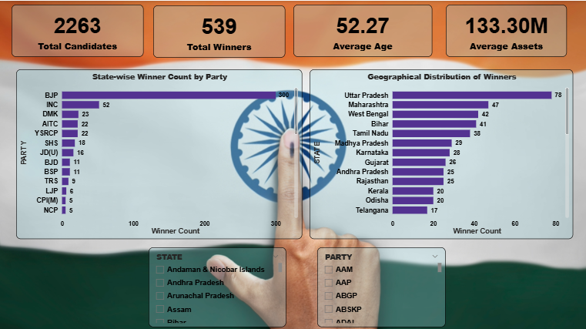
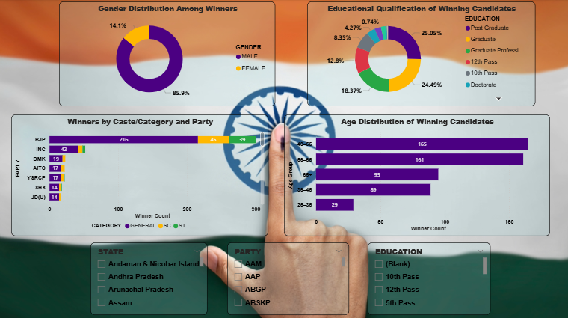
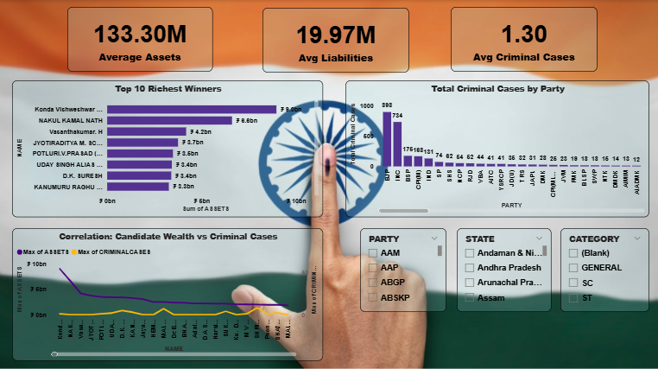
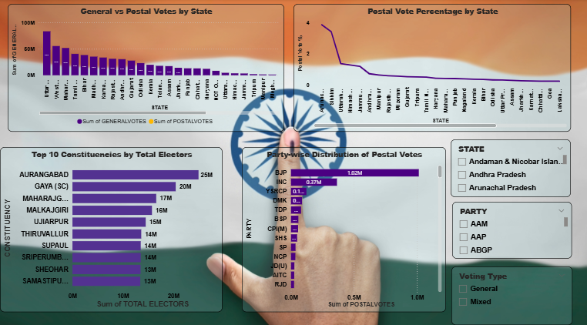
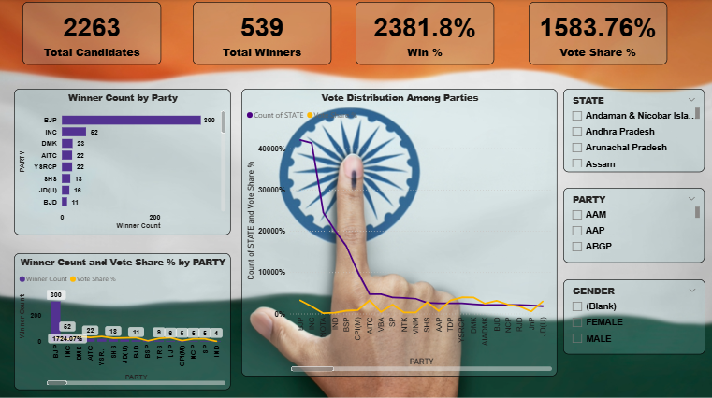
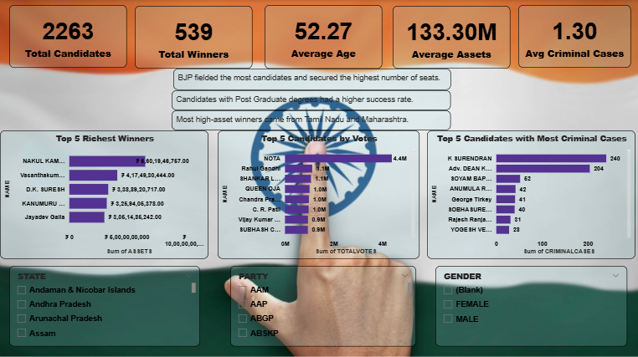
Dashboard Screenshot
Notes:
Overview of dashboards created

Slide 9
Challenges Faced
Challenge | How We Solved It
Raw dataset inconsistencies | Manual cleaning + Power Query transformations
Different name formats in data | Applied uniform naming conventions
Complex DAX requirements | Built modular formulas step-by-step
Visual overcrowding | Followed BI design principles for clarity
Ensuring accuracy | Re-validated all numbers manually
Notes:
Explain how obstacles were solved

Slide 10
Key Insights
Majority winning candidates were male
Higher educational background linked with higher win success
Wealthier candidates had higher winning probability
BJP won the maximum constituencies nationwide
Some candidates with criminal cases still won
Postal votes played a crucial role in selected states
These findings support public understanding and media analysis of electoral trends.
Notes:
Present main findings

Slide 11
Learning Outcomes
Through this project, we learned:
Practical Power BI dashboard development
Data cleaning and modeling techniques
Importance of consistent data structure
DAX formula building for performance metrics
Storytelling with data to ensure clarity
Effective teamwork & task management
This experience improved both our technical and collaborative capabilities.
Notes:
Share skills gained

Slide 12
Future Scope
Possible improvements and extensions:
Real-time election updates using API integration
Machine learning-based vote prediction model
Web-based visualization hosting
Mobile version of dashboard
Sentiment analysis based on social media during elections
These upgrades can make the model industry-ready.
Notes:
Discuss extension ideas

Slide 13
Conclusion
This project successfully turned large-scale election data into interactive visual insights.
It strengthened our skills in data handling, BI tools, DAX, visualization, and professional reporting.
The dashboard is a useful tool for political analysts, media personnel, and research purposes.
Notes:
Summarize & close

Slide 14
Thank You
Thank you for your time and attention!
We are happy to answer any questions or discuss the project further.
Notes:
Thank audience & open for questions

